Slide 1
Tower Defense Game Framework
By: Erfan Tavakoly, Alireza Sanaee
Course: Software Architecture
Date: 29/12/2017

Slide 2
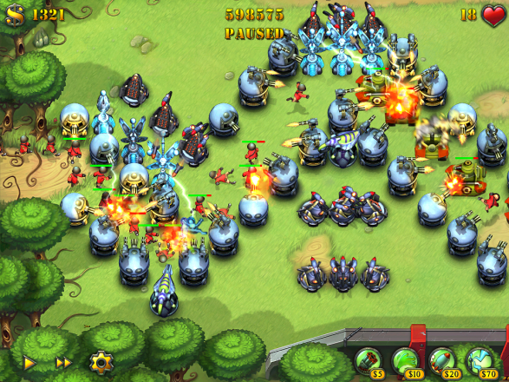
What is Tower Defense Game

Slide 3
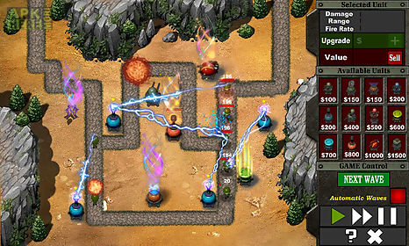
Goal of the Game
Stop enemies from reaching the endpoints.

Slide 4
Game Mechanics
A Map with Start Points and End Points and at least one path approaching endpoints
Putting towers and instruments throughout the way of the enemies
Enemy comes in finite waves and troops(there are also endless games)
Tower building, removing, and upgrading are available

Slide 5
Tower Defense Framework
Design Enemies
Design Towers
Design Upgrades
Design Levels
Design Maps
Design PowerUp
Some Game managements

Slide 6
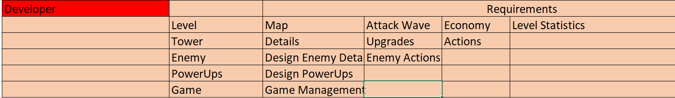
Primitive Entities

Slide 7
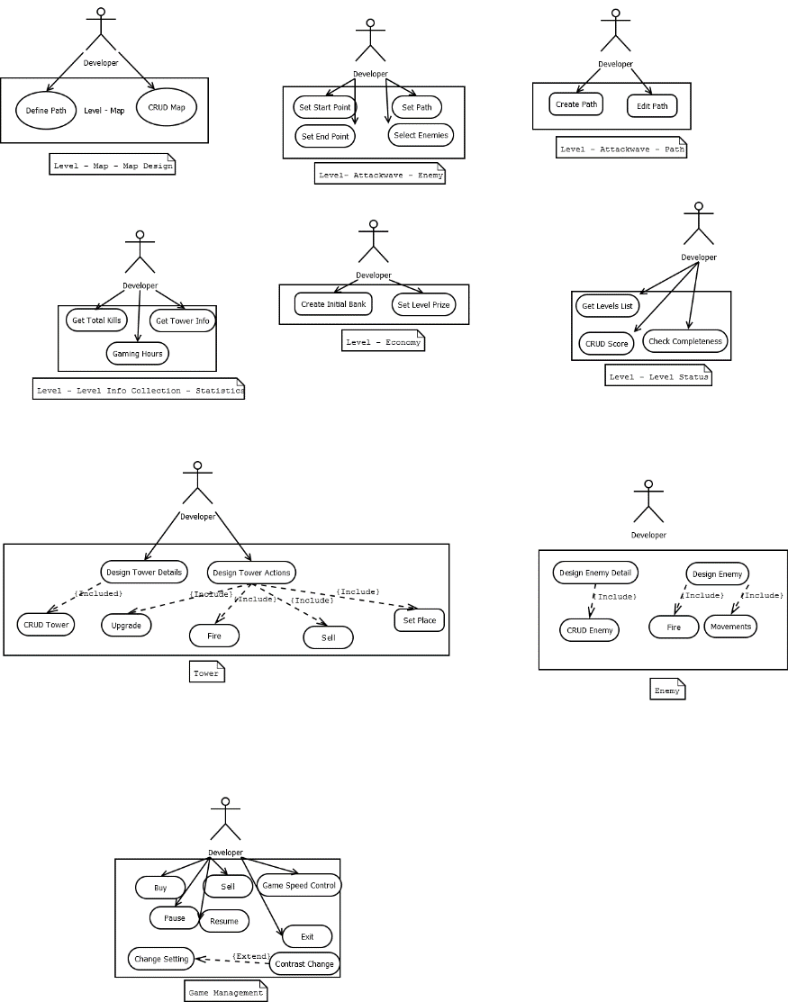
Use Cases

Slide 8
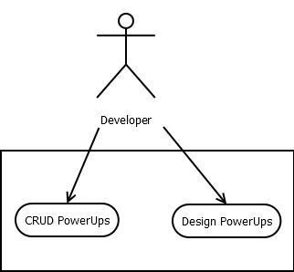
PowerUps

Slide 9
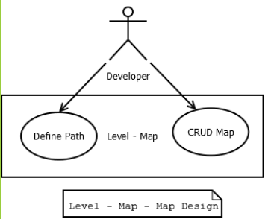
Use Cases – Level - Map

Slide 10
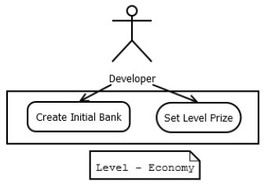
Use Cases – Level - Economy

Slide 11
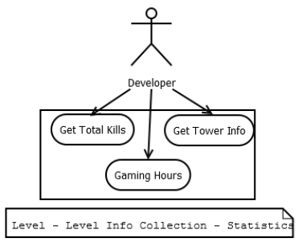
Use Cases – Level - Statistics

Slide 12
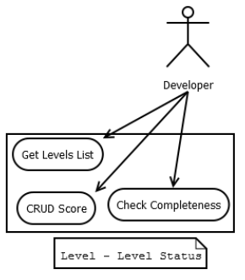
Use Cases – Level - Status

Slide 13
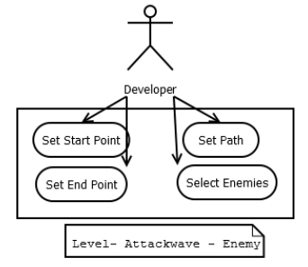
Use Cases – Attackwave

Slide 14
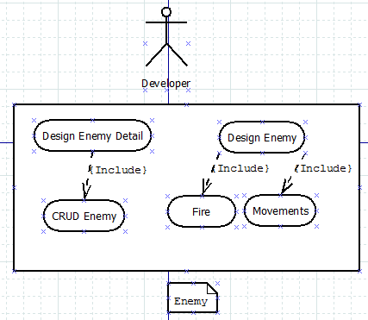
Use Cases – Enemy

Slide 15
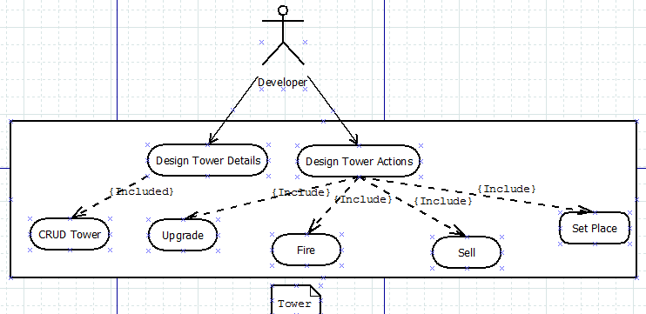
Use Cases – Tower

Slide 16
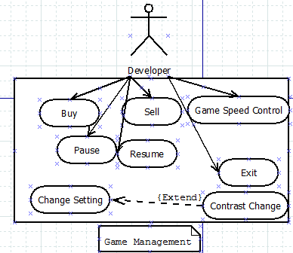
Use Cases – Game Management

Slide 17
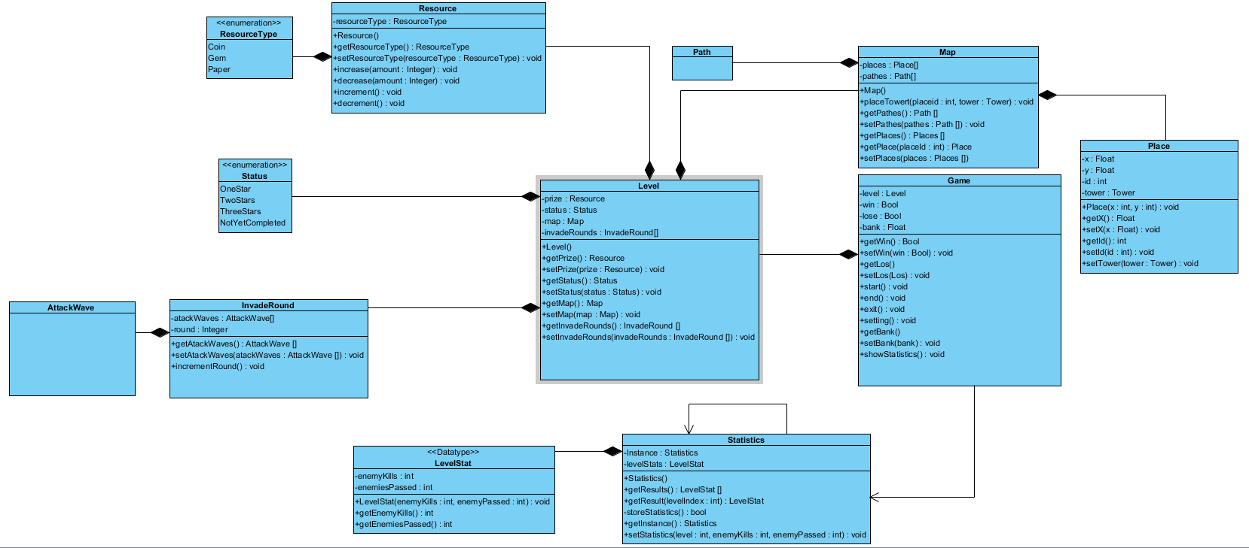
Level_Package Class Diagram

Slide 18
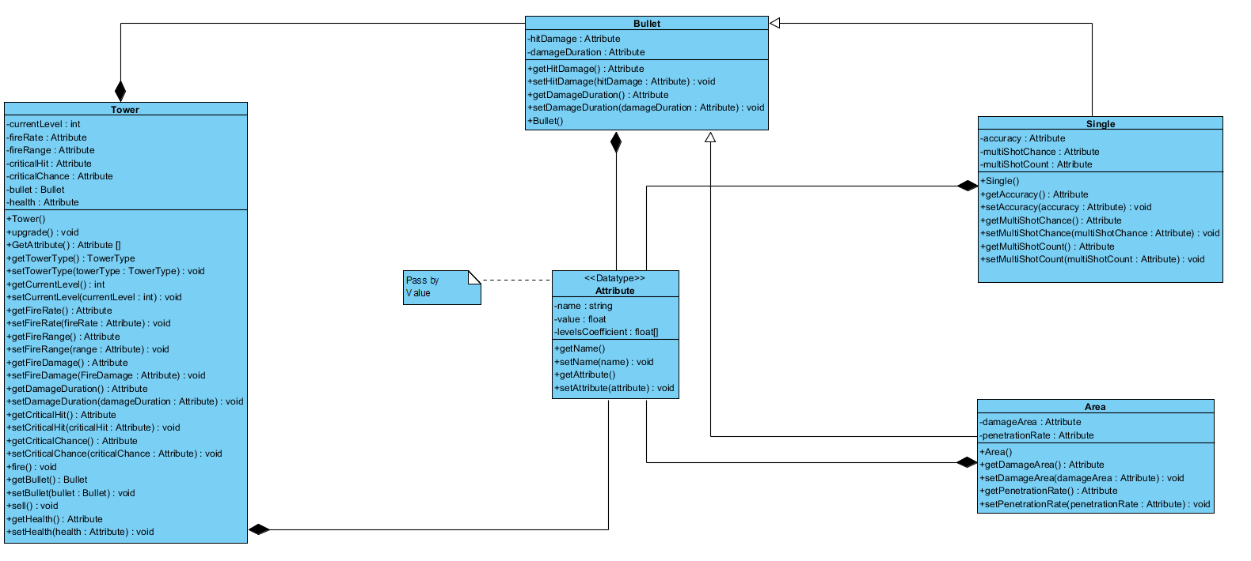
Tower_Package Class Diagram

Slide 19
Class Diagram_ Note
Refer to visual paradigm for better visual quality
Source codes are also generated

Slide 20
Future works
Complete the rest of the classes
Enemies
Attack Waves
Path
Store
Implement the base functionality
Unity Plugin

Slide 21
What we have done?!
Enemy
Attackwave
Invade Round
Enemy
Tower
Tower
TowerScope
Bullet

Slide 22
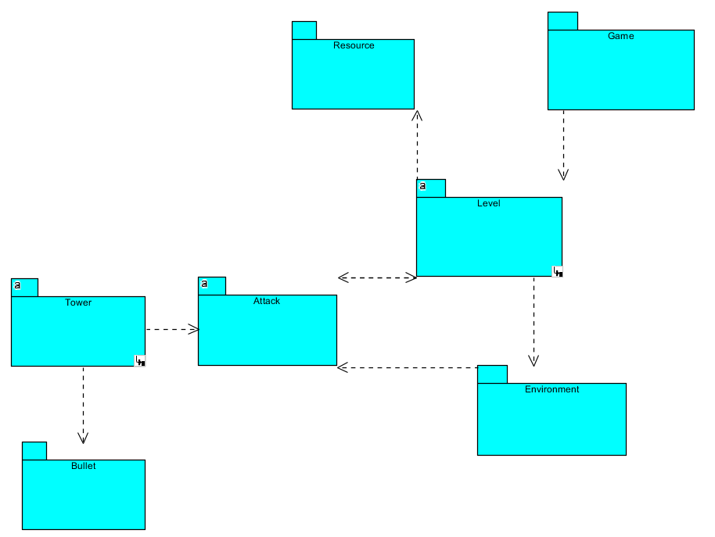
Packaging

Slide 23
What we have done?! – Cont.
Level
Status
Map
Place
TowerHudManger
TowerHud
Miscellaneous
AssetManger
Game
Statistics
LevelState
Resource
Resource
ResourceType

Slide 24
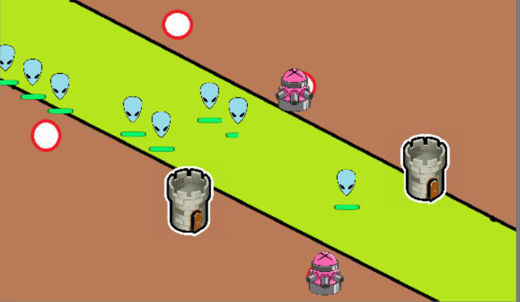
Demo

Slide 25
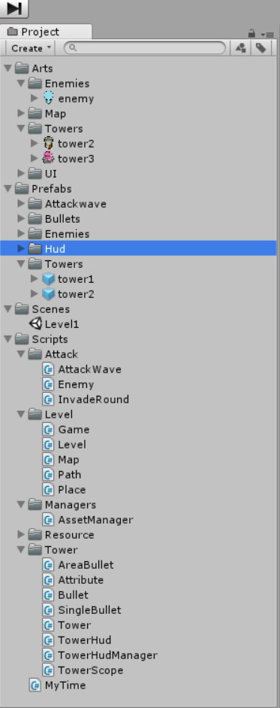
Demo

Slide 26
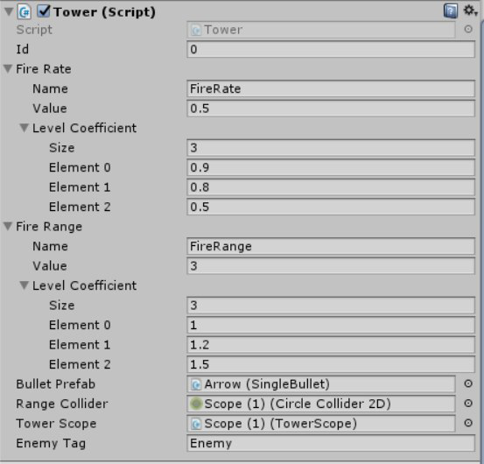
Demo

Slide 27
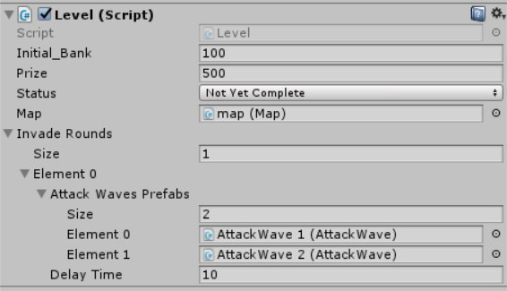
Demo

Slide 28
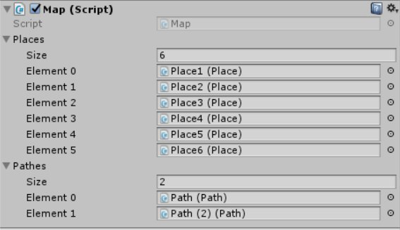
Demo

